Slide 1
X-section C-D
See Cross section locations.kmz & Cross section labels.kmz for location in Google Earth

Slide 2


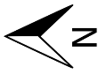
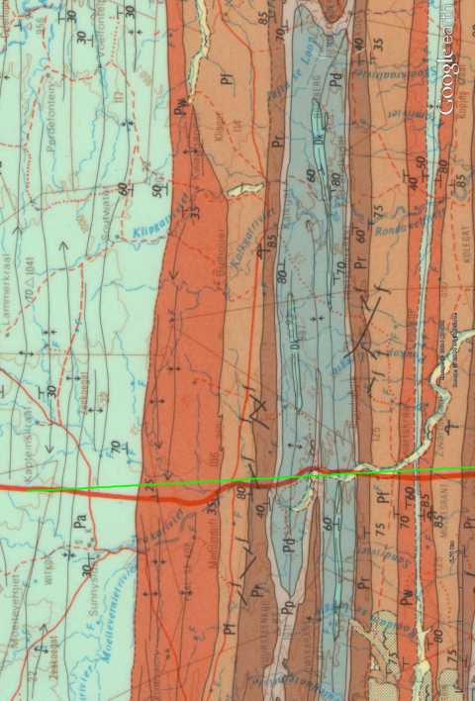
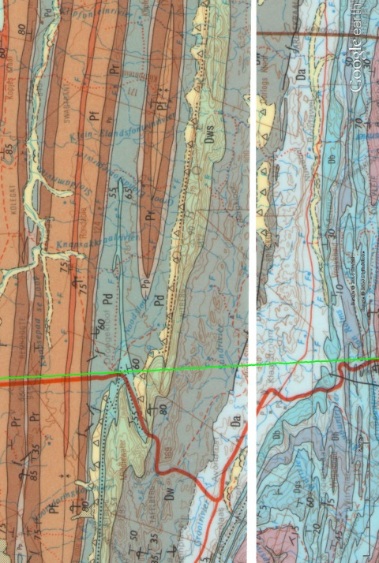
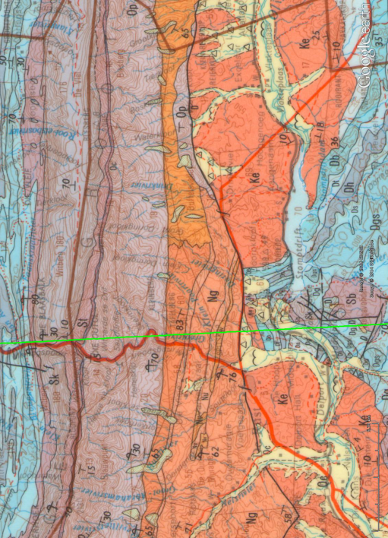
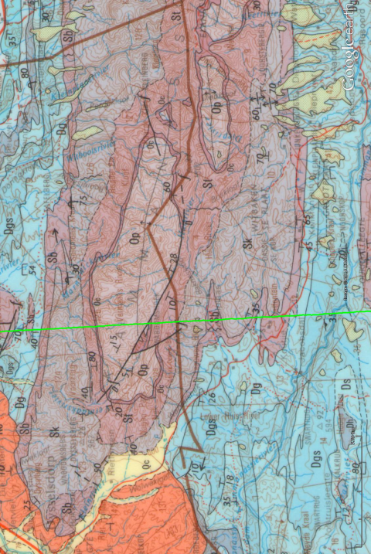
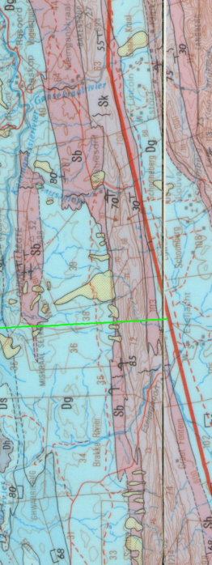

Simplified Geologic Cross- ection C-D
Vertical exaggeration: 6.7x
D
C
Klaarstroom
De Rust
ƒ
ƒ
ƒ
ƒ
Kammanassie
masl
Witberg
Swartberg
Kango fault
Pa
Pw
Dk
Dw
Sb
Pf
Dws
Pd
Da
Dg
Dg
Sk
Dg
Pr
Sk
St
Sk
Pd
St
St
0
Sb
Sk
Op
Oc
Db
Sk
Op
Op
Dw
Dt
St
Dh
Op
Ds
Ngw, Nu, Nv, Ng
Dgs
Da
Dg
Op
Ngw, Nu, Nv, Ng
Nmg
Nmg
Nmg
Sb
St
Sk
C
D
Km

Slide 3
C-D

